Slide 1
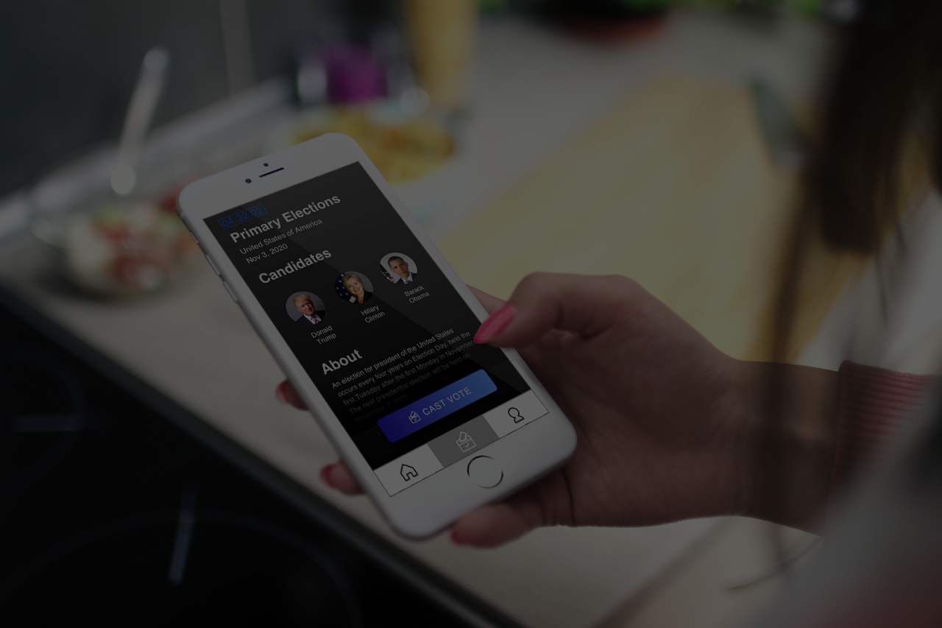

Ethan Finkel, Claire Kantner, Kwon Tack Lim, Fama Ndiaye, Leo Wu
HyconHacks 2018

Slide 2


Over $1,000,000
Total cost of USA General Election in 2016
http://time.com/money/4556642/election-day-2016-costs-country-voters/
Notes:
In the 2016 election, the US lost over 1 billion dollars in organizing the election on the day of. Physically going to the polling station wastes time and money. Lines alone were responsible for turning away 700,000 votes in the 2012 election.

Slide 3
Voting is hard.
Several barriers exist in the voting space:
ACCESSIBILITY
TRANSPARENCY
SECURITY
Complex registration
Time consuming
Inefficient, costly elections
LACKING
Notes:
The current voting system is too much work for voters. Lines at polling locations waste too much time on election day, and cost way too much to run. The current election system is also too open to fraud, and makes it hard for underserved communities to vote. We seek to solve this problem by making voting as seamless as possible.

Slide 4
How can we make voting more accessible?
Notes:
With VOTE BLOCK we are trying to make voting more accessible

Slide 5
Vote Block Principles
Security
Accessibility
Transparency
It is extremely difficult to breach an election
Votes can be cast from your phone, any location, allowing for a more equal representation of voters
There is no ambiguity as to if there was a miscount
Notes:
We want elections to be secure, accessible, and transparent. We are planning on using state of the art blockchain and cryptographic technology to make sure real people are casting real votes anonymously

Slide 6
Vote Block Principles
Security
Accessibility
Transparency
It is extremely difficult to breach an election
Votes can be cast from your phone, any location, allowing for a more equal representation of voters
There is no ambiguity as to if there was a miscount
Notes:
To make the election more secure, we are eliminating the need to trust. Currently, voting machines are antiquated and regularly are being proven to have fatal weaknesses. Russian hacking into the U.S election has been one of the biggest stories this year. With a blockchain system the election will be unbreachable by hackers.

Slide 7
Vote Block Principles
Security
Accessibility
Transparency
It is extremely difficult to breach an election
Votes can be cast from your phone, any location, allowing for a more equal representation of voters
There is no ambiguity as to if there was a miscount
Notes:
Today, people are forced to go to polling locations to vote. This costs voters time and money while they wait in line and commute. Centralized voting locations also disproportionately affect poor communities where in some places they have to travel over 10x further.

Slide 8
Vote Block Principles
Security
Accessibility
Transparency
It is extremely difficult to breach an election
Votes can be cast from your phone, any location, allowing for a more equal representation of voters
There is no ambiguity as to if there was a miscount
Notes:
Elections are not transparent enough now. With voting on the blockchain, anyone can perform a recount and check that the votes are accurate.

Slide 9
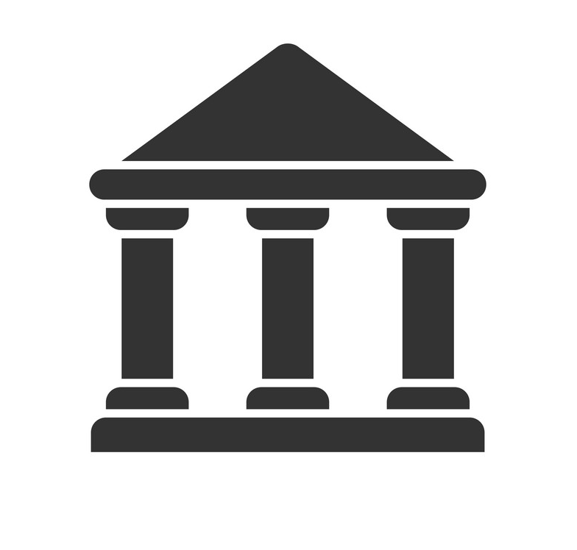
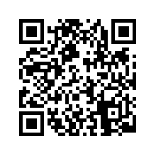


Before the Election
VISIT YOUR LOCAL AGENCY
BRING YOUR ID
QR CODE BY GOV
Notes:
To register for an election, you simply visit your local agency and get signed up as a voter with your ID. This ID is securely stored on the blockchain and accessible with a decryption key that you scan and store locally. This process is done with a program called Bassid that encrypts and scatters fragments of the ID.

Slide 10
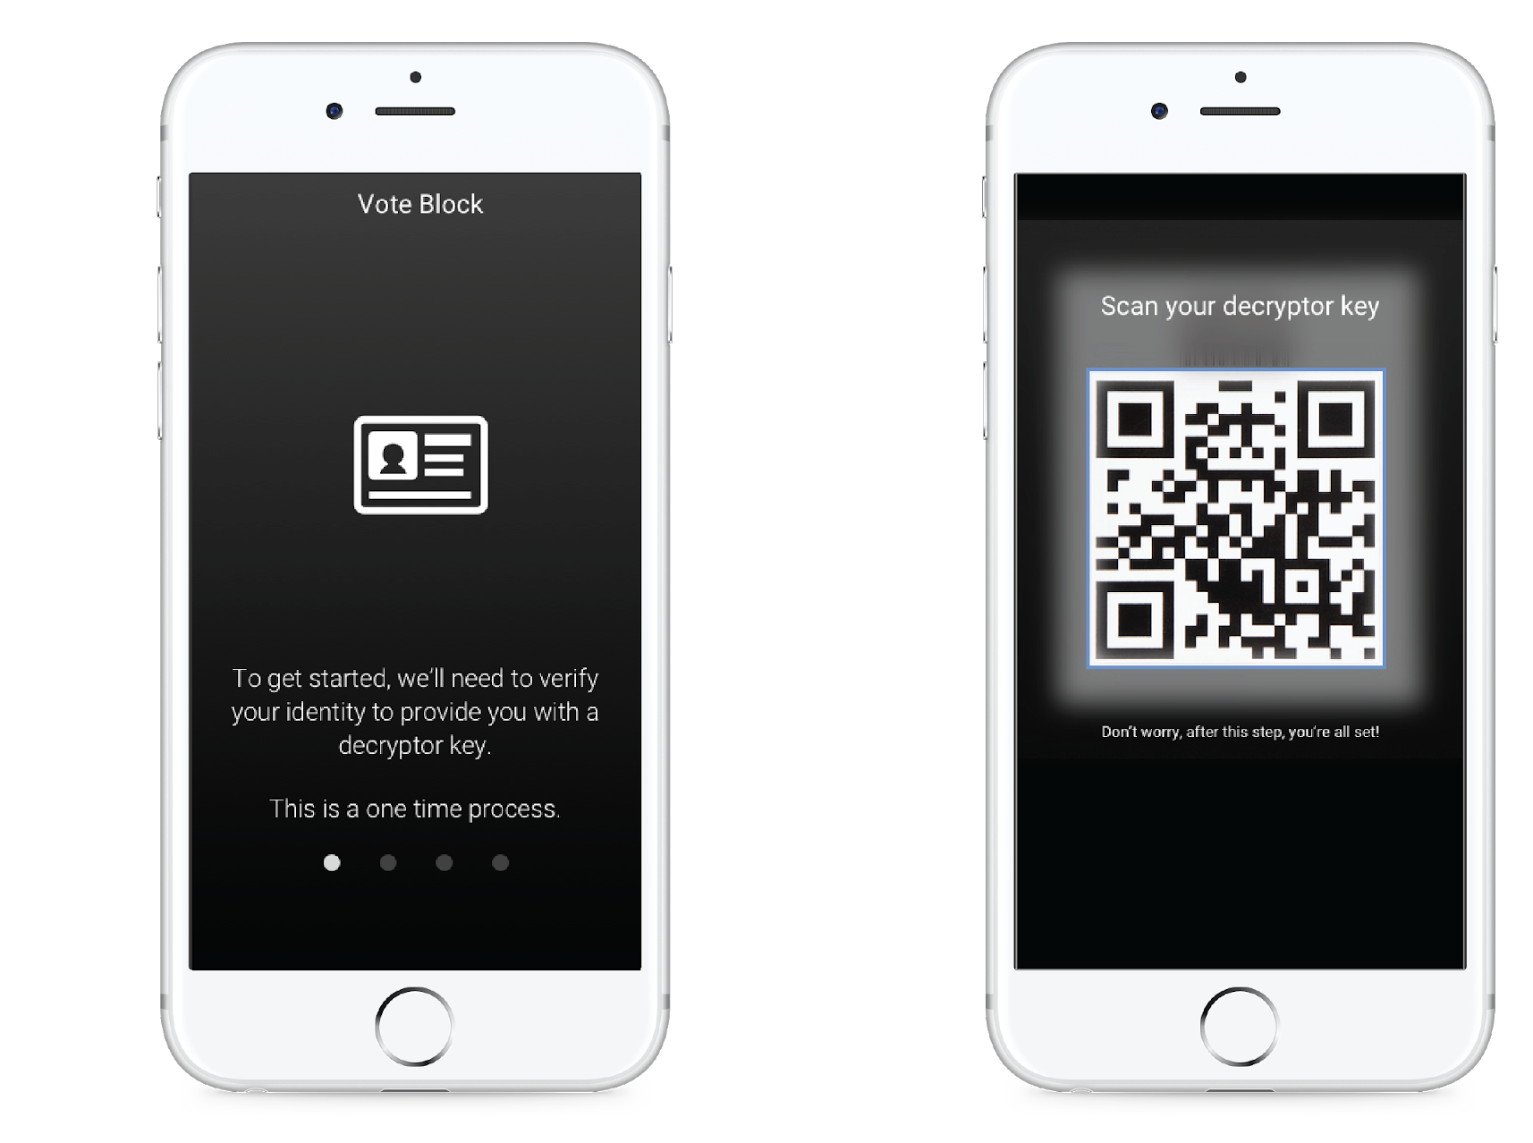
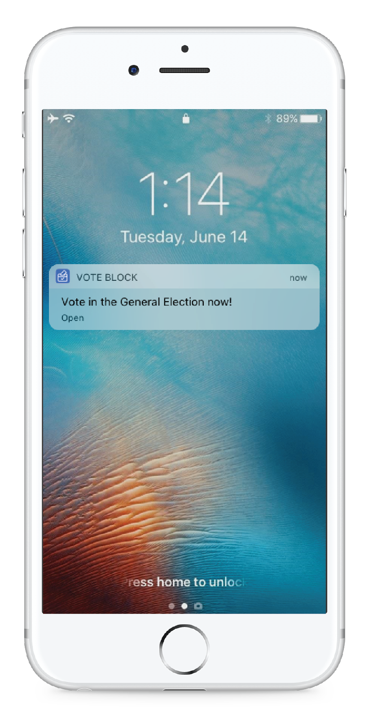
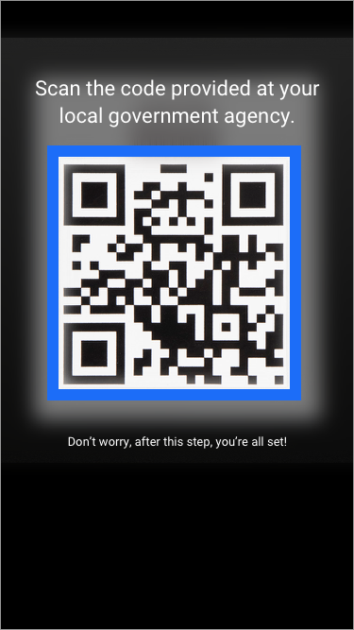
Scanning Govt. Issued Key (QR code)
Instructions to Register
Notification of Voting Period
Notes:
The app is intuitive from a user side where you can scan a QR code at the registration office to save your decrypter key for the day of the election.

Slide 11
The Day of the Election
LOG INTO
VOTE BLOCK
DECRYPTION KEY IS CHECKED
GENERATE PUBLIC AND PRIVATE KEY
USE ZERO KNOWLEDGE PROOF TO VERIFY THAT YOU ARE REGISTERED
VOTE
Notes:
The process on election day for users is simple. All of the technical work happens automatically behind the scenes. After checking the user is registered with the government, VOTE BLOCK generates keys for the user automatically, and then uses a zero-knowledge proof behind the scenes to talk to the government!

Slide 12
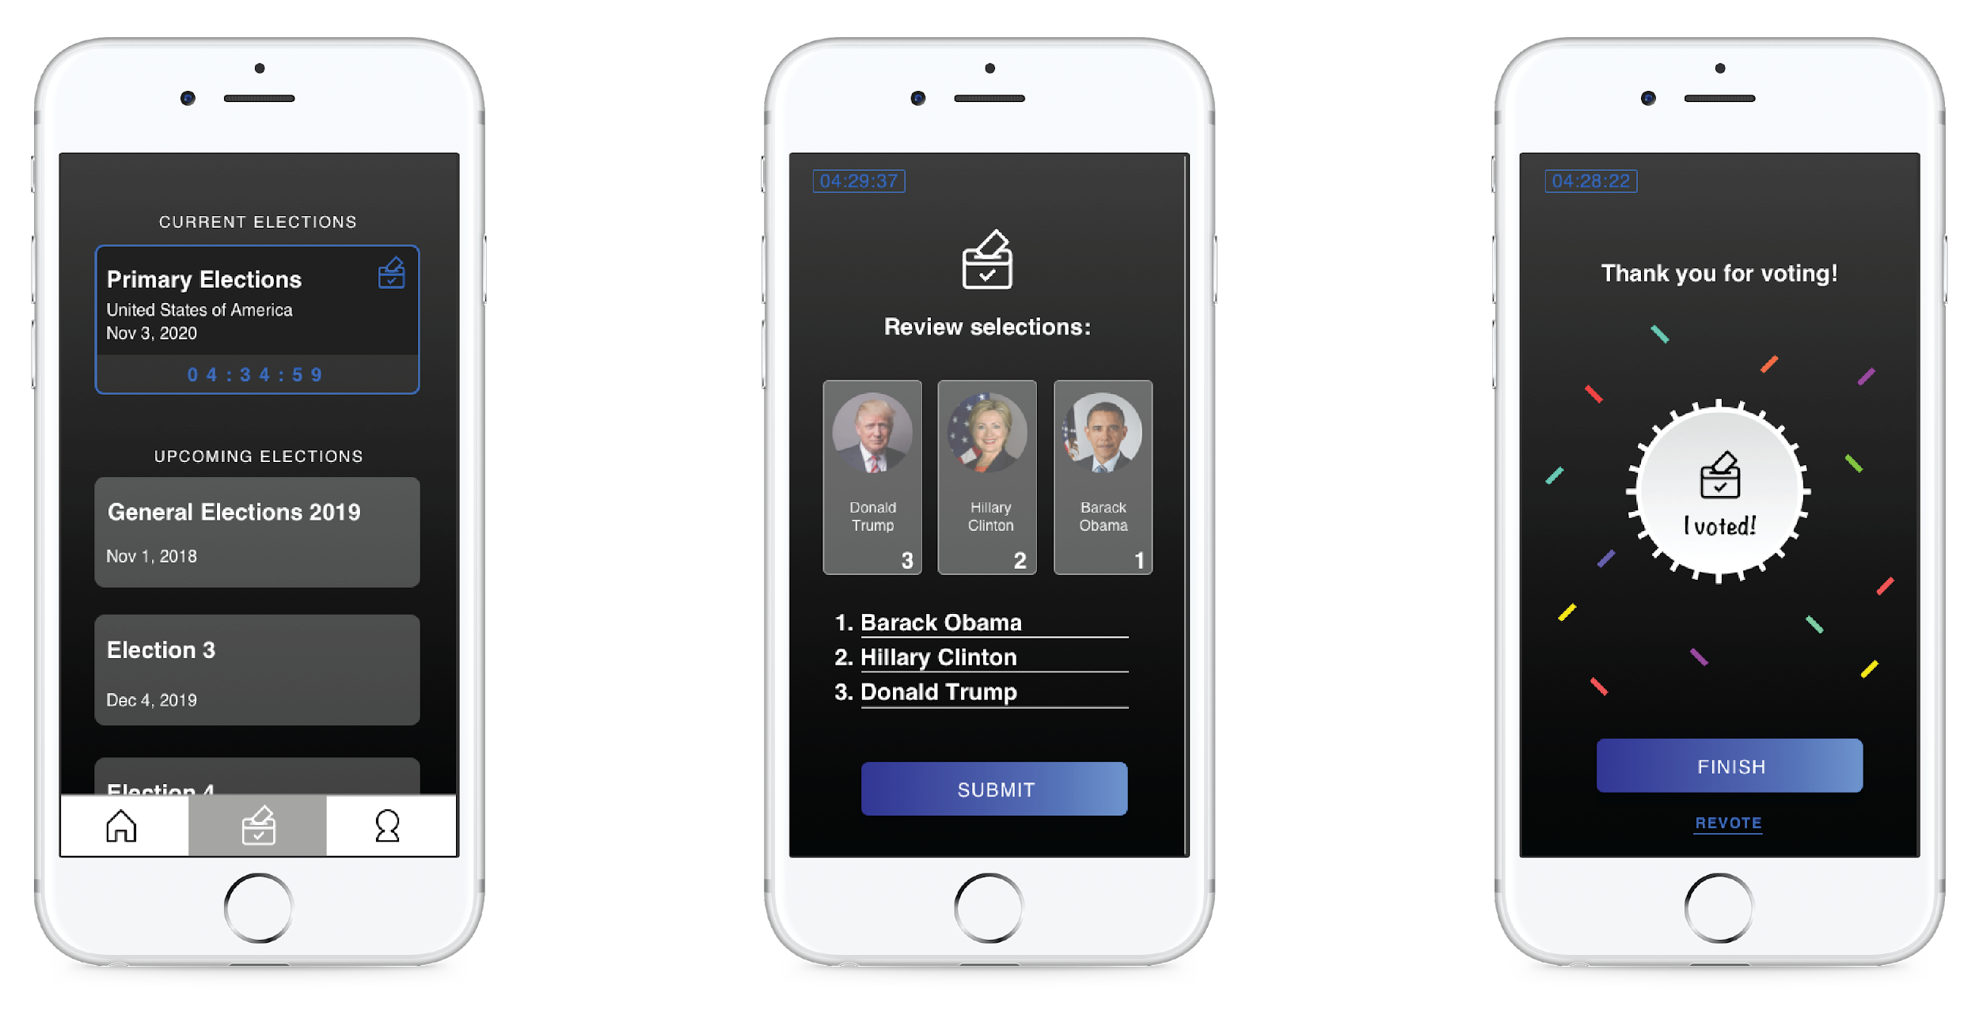
Homepage
(with countdown to deadline)
Tap to Select Order of Ideal Vote
Reward Political Activism
Notes:
Election data is stored in the proto field of the hycon blockchain. By adding additional fields in the account details, VOTE BLOCK supports runoff voting systems. For a first past the post system, the values are simply stored as a zero or a one.

Slide 13
Future Improvements
If we had more time, we would implement...
Tokenization
Zero Knowledge Proofs
Implementing tokens can incentivize voting
To validate, but anonymize transactions
Notes:
In the future, VOTE BLOCK will implement a token system to create incentives for voters to vote. Zero Knowledge proofs are a very complicated subject and take a little bit more time than 36 hours to understand and employ.

Slide 14
Thank you
Notes:
In the future, VOTE BLOCK will implement a token system to create incentives for voters to vote. Zero Knowledge proofs are a very complicated subject and take a little bit more time than 36 hours to understand and employ.

Slide 15
Thank You!

